Slide 1
GreenLens
Go green
CIEL KINGSTON VIBEAITHON 2025

Slide 2


GreenLens – Product Sustainability Scanner
GreenLens is an innovative app aimed at tackling greenwashing and enhancing transparency in consumer products. By simply scanning barcodes or QR codes, users can uncover the genuine environmental impact of products, empowering them to make informed and sustainable choices. This tool promotes a more responsible approach to consumption and encourages companies to prioritize sustainability.

Slide 3

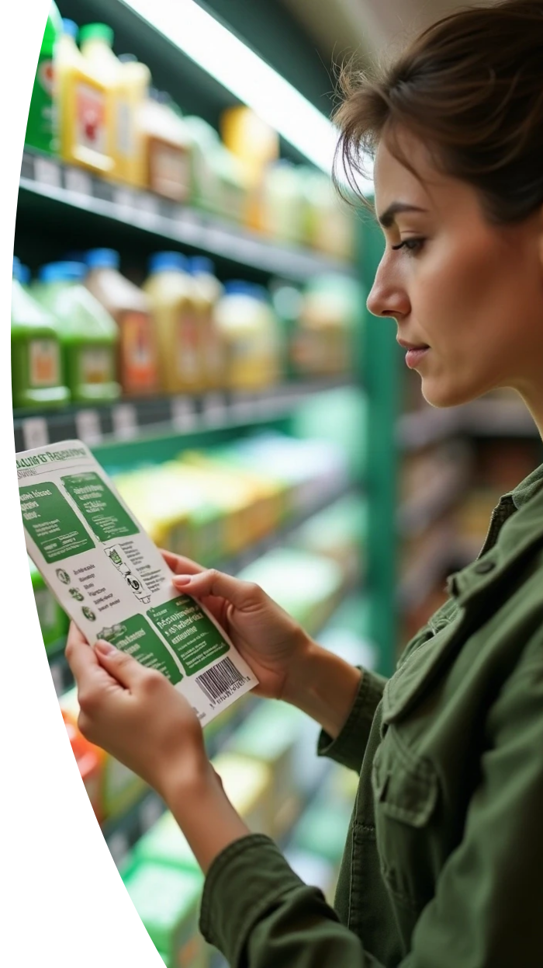

Addressing Key Sustainability Issues
Greenwashing Awareness
Many brands mislead consumers with exaggerated sustainability claims, creating confusion and mistrust in the market.
Lack of Transparency
Consumers often struggle to find verified information about the environmental and ethical impacts of products, hindering eco-conscious choices.
Informed Decision-Making
GreenLens empowers consumers by providing accurate sustainability data on products, enabling smarter purchases that align with their values.

Slide 4




Sustainability Product Insights
Impact Metrics
The app rates products based on crucial factors such as carbon footprint, plastic content, ethical labor practices, and supply chain emissions.
Product Scanning
Users can quickly scan barcodes or QR codes to retrieve comprehensive sustainability information on products in real-time.
Brand Comparison
Users can compare different brands easily to choose truly sustainable alternatives.
2
1
3

Slide 5
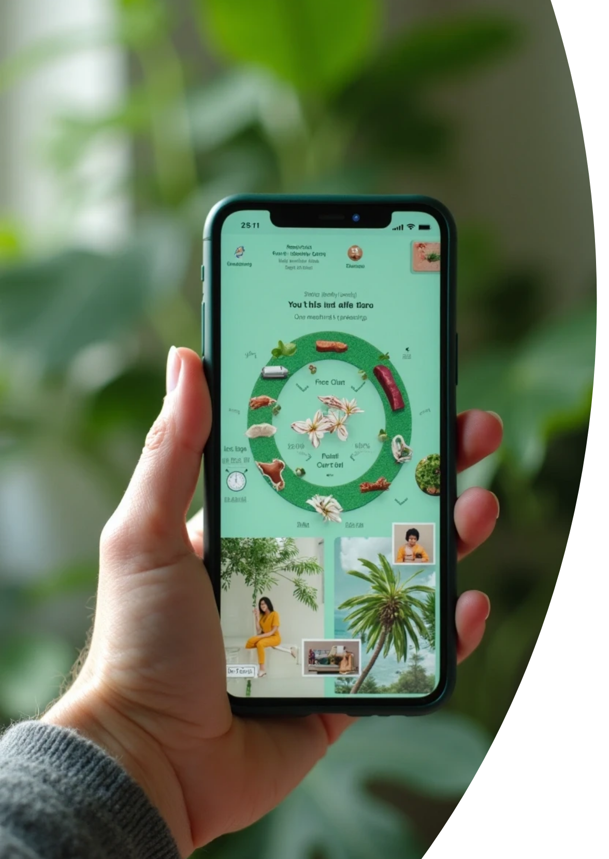



Innovative Twist
1
AR Overlay Feature
Visualizes a product's lifecycle including origins and options.
2
Eco-Friendly Suggestions
Recommends sustainable alternatives nearby or online.
3
Gamification Element
Users earn eco-points and badges for sustainable choices.

Slide 6




Impact of GreenLens
1
Sustainable Consumer Habits
GreenLens promotes more environmentally responsible purchasing behaviors, leading to a positive shift in consumer habits.
2
Reduced Greenwashing
By providing authentic data, the app diminishes the prevalence of misleading marketing claims and holds companies accountable.
3
Ethical Production Encouragement
Increased consumer awareness drives brands to adopt transparent and ethical production practices, fostering a culture of responsibility.

Slide 7




Future Enhancements
Community Insights
Adding user-generated reviews and insights will enhance credibility and assist others in making informed decisions about products.
Integration with Shopping Platforms
2
Future updates may include direct integration with popular online shopping platforms for seamless eco-friendly purchasing.
1
Partnerships
3
Collaborating with verified sustainability organizations can enhance the app's data accuracy and expand its credibility in the market.

Slide 8



Conclusion
Revolutionizing Choices
Tackling Greenwashing
Promoting Transparency
GreenLens changes the way consumers choose products.
The platform addresses misleading environmental claims.
It encourages brands to disclose their sustainability efforts.
Empowering Users
Fostering a Healthier Planet
Users can make informed, eco-conscious decisions.
The ultimate goal is creating a sustainable environment for future generations.

Slide 9
Thank You
Contact details :-
email : rsaraal3@gmail.com
LinkedIn: Saraal R
GitHub : rsaraal3-jpg
Ph.no : 8525916288

